Slide 1
MLB Second Half Stars
by Peter DePaul III

Slide 2
Overview
We will be observing MLB players stats from both halves of the season
1st Half is through June 27th, 2024
2nd Half is June 28th, 2024 through September 15th, 2024
We will be looking for the largest jumps in the average difference for select variables
Data Split into Hitters and Pitchers
“+”/”-” Stats are context normalized (ballpark, weather, elevation, etc.)

Slide 3
Briefer
To understand what we will talk about in further sections you need to understand percentiles
Range from 0th percentile to 100th percentile (0.000 to 1.000)
83rd percentile means that 17 percent of the data has a better score in that column
100th percentile would indicate the best player at specific column
Hope this clears it up!

Slide 4
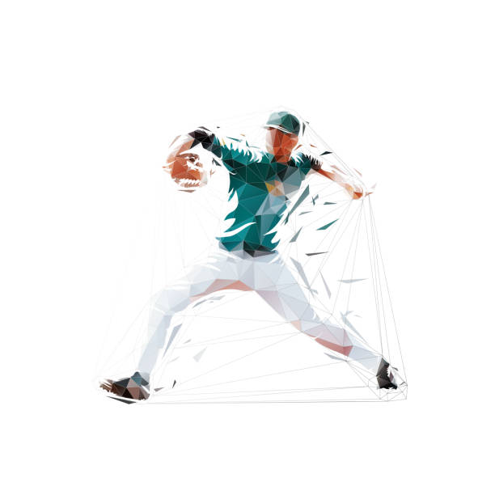
Pitchers
Columns for Ranking
K/BB+ Walk:Strikeout+ | WPA Win Probability Added | WAR Wins Above Replacement
Clutch | ERA- | FIP-
AVG+ | WHIP+ Walks + Hits Per Innings Pitched+ | HR/9+ HR per 9+

Slide 5
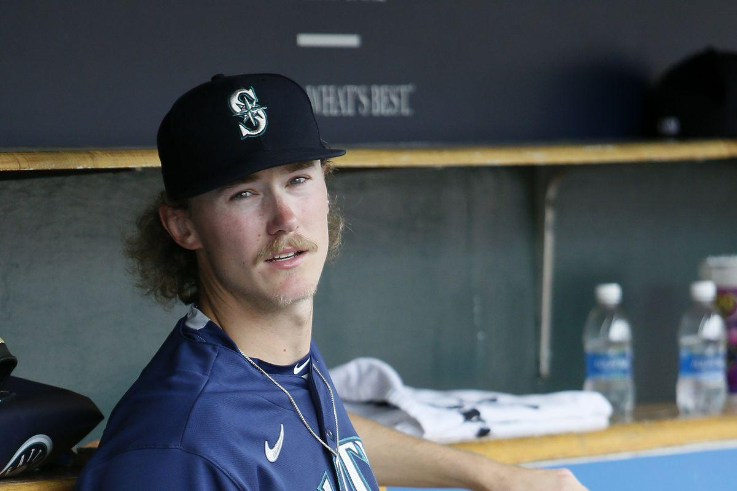
Bryce Miller
What are you looking at?
1st Half: (75 Total Pitchers)
ERA-: 23rd Percentile
FIP-: 21st Percentile
K/BB+: 44th Percentile
HR/9+: 16th Percentile
AVG+: 83rd Percentile
WHIP+: 77th Percentile
WPA: 33rd Percentile
Clutch: 4th Percentile
WAR: 19th Percentile
2nd Half: (70 pitchers)
ERA-: 93rd Percentile (+70)
FIP-: 86th Percentile (+65)
K/BB+: 93rd Percentile (+49)
HR/9+: 76th Percentile (+60)
AVG+: 84th Percentile (+1)
WHIP+: 91st Percentile (+14)
WPA: 97th Percentile (+54)
Clutch: 87th Percentile (+83)
WAR: 81st Percentile (+62)
Average Percentile Difference = +52 percentiles

Slide 6
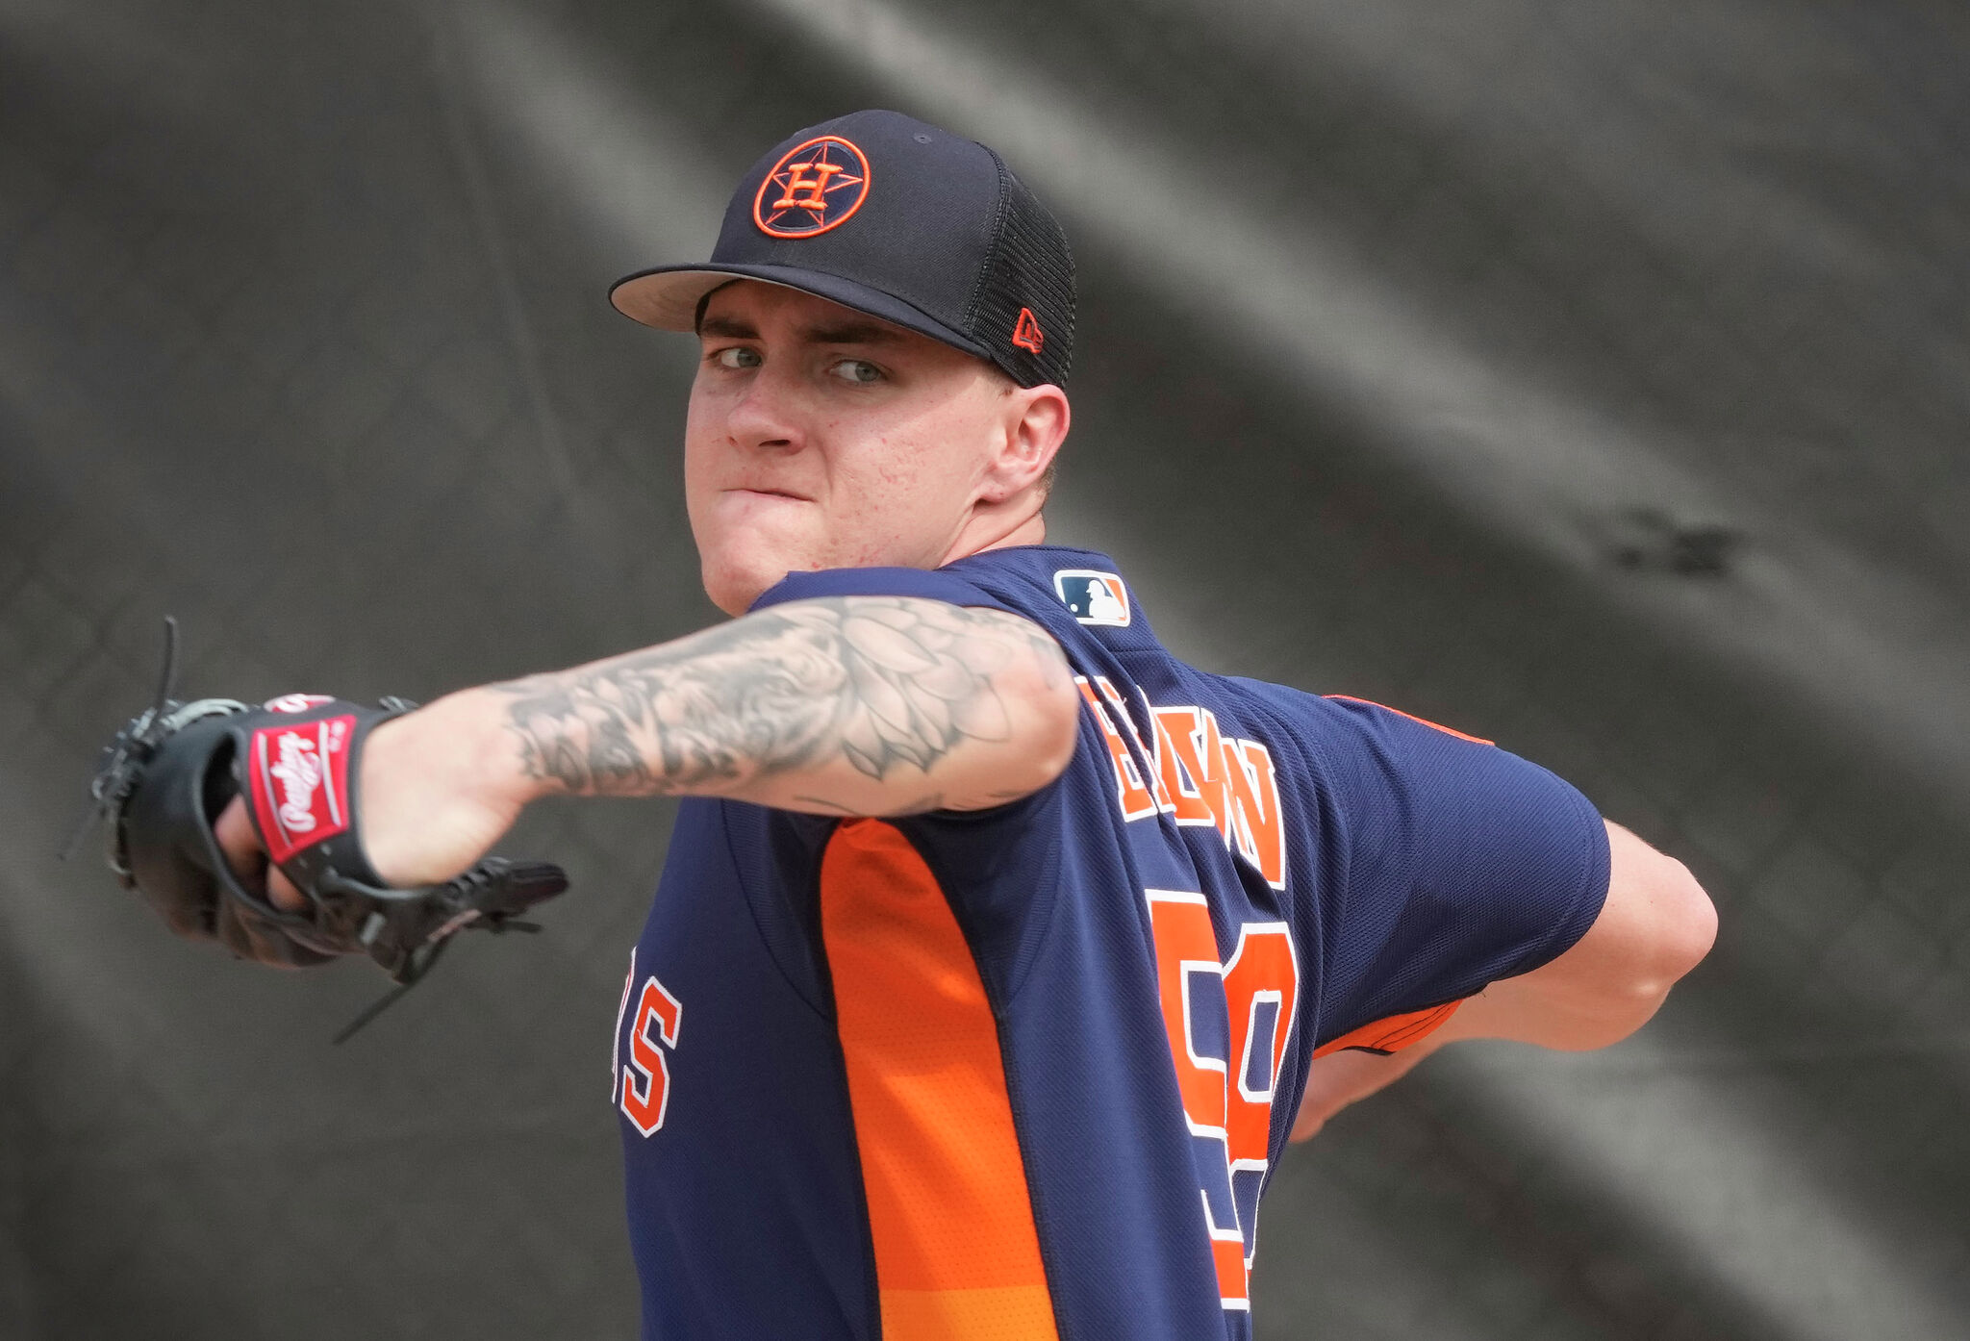
Hunter Brown
1st Half:
ERA-: 15th Percentile
FIP-: 27th Percentile
K/BB+: 32nd Percentile
HR/9+: 19th Percentile
AVG+: 19th Percentile
WHIP+: 5th Percentile
WPA: 28th Percentile
Clutch: 47th Percentile
WAR: 21st Percentile
2nd Half:
ERA-: 83rd Percentile (+68)
FIP-: 91st Percentile (+64)
K/BB+: 37th Percentile (+5)
HR/9+: 93rd Percentile (+74)
AVG+: 46th Percentile (+27)
WHIP+: 44th Percentile (+39)
WPA: 90th Percentile (+62)
Clutch: 86th Percentile (+39)
WAR: 91st Percentile (+70)
Average Percentile Difference: +50 percentiles

Slide 7
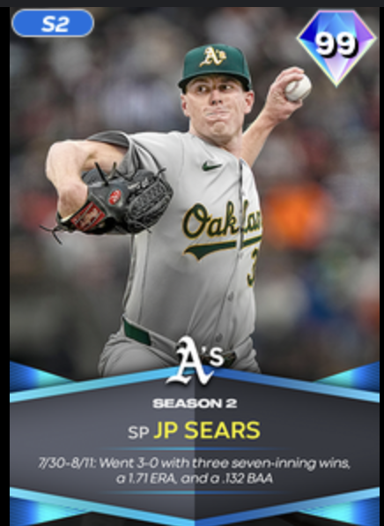
JP Sears
1st Half:
ERA-: 5th Percentile
FIP-: 1st Percentile
K/BB+: 9th Percentile
HR/9+: 28th Percentile
AVG+: 16th Percentile
WHIP+: 13th Percentile
WPA: 7th Percentile
Clutch: 72nd Percentile
WAR: 4th Percentile
2nd Half:
ERA-: 66th Percentile (+61)
FIP-: 46th Percentile (+45)
K/BB+: 73rd Percentile (+64)
HR/9+: 59th Percentile (+31)
AVG+: 63rd Percentile (+47)
WHIP+: 76th Percentile (+63)
WPA: 70th Percentile (+63)
Clutch: 74th Percentile (+2)
WAR: 53rd Percentile (+49)
Average Percentile Difference: +47 percentiles

Slide 8
Discussing Pitchers
Incredible performances by all of these guys
Bryce Miller has been the third best pitcher in baseball since June 28th
Hunter Brown went from being the 8th worst pitcher to being in the 75th percentile in the 2nd half
JP Sears went from being the 4th worst pitcher to being in the 64th percentile in the 2nd half
All three of these jumps are unprecedented, but highlight a pitcher’s ability to turn it around, or maybe just have a little luck on their side

Slide 9

Batters
Columns for Ranking
BB/K | wOBA
Def | Off
wRC+ | BB%+
OBP+ | SLG+
ISO+ | WPA
Clutch | WAR
K%+

Slide 10
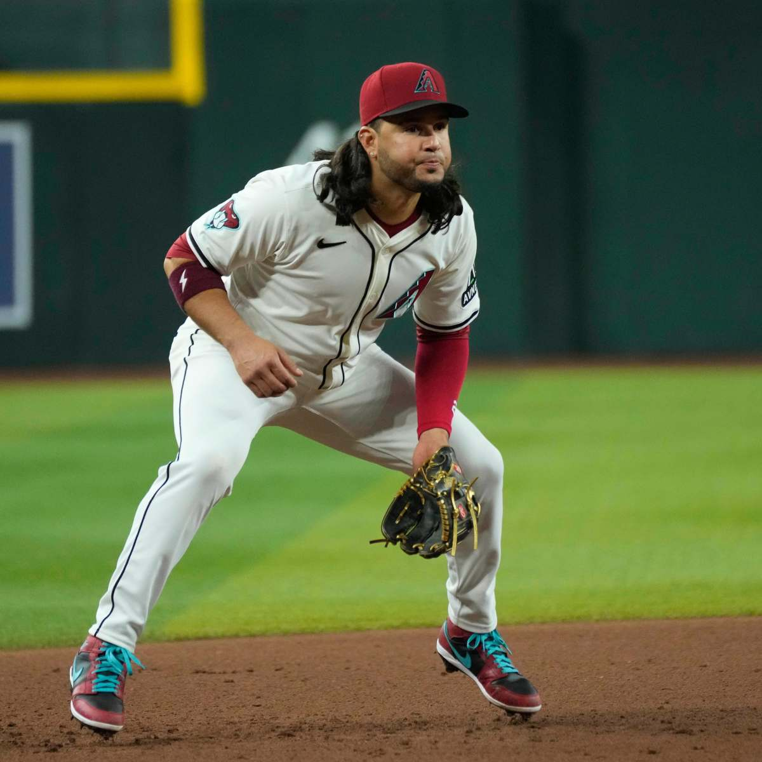
Eugenio Suárez
1st Half:
Def: 71st Percentile
Off: 1st Percentile
wRC+: 1st Percentile
BB%+: 47th Percentile
K%+: 10th Percentile
OBP+: 4th Percentile
SLG+: 2nd Percentile
ISO+: 19th Percentile
WPA: 10th Percentile
Clutch: 54th Percentile
WAR: 8th Percentile
2nd Half:
Def: 73rd Percentile (+2)
Off: 96th Percentile (+95)
wRC+: 96th Percentile (+95)
BB%+: 42nd Percentile (-5)
K%+: 36th Percentile (+26)
OBP+: 92nd Percentile (+88)
SLG+: 97th Percentile (+95)
ISO+: 100th Percentile (+81)
WPA: 76th Percentile (+66)
Clutch: 15th Percentile (-29)
WAR: 98th Percentile (+90)
Average Percentile Difference = +54 percentiles

Slide 11
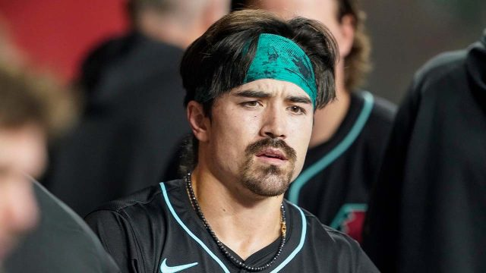
Corbin Carroll
1st Half:
Def: 60th Percentile
Off: 14th Percentile
wRC+: 5th Percentile
BB%+: 73rd Percentile
K%+: 69th Percentile
OBP+: 24th Percentile
SLG+: 1st Percentile
ISO+: 6th Percentile
WPA: 49th Percentile
Clutch: 90th Percentile
WAR: 25th Percentile
2nd Half:
Def: 58th Percentile (-2)
Off: 93rd Percentile (+79)
wRC+: 87th Percentile (+82)
BB%+: 66th Percentile (-7)
K%+: 57th Percentile (-12)
OBP+: 58th Percentile (+34)
SLG+: 92nd Percentile (+91)
ISO+: 96th Percentile (+90)
WPA: 97th Percentile (+48)
Clutch: 97th Percentile (+7)
WAR: 93rd Percentile (+68)
Average Percentile Difference = +43 percentiles

Slide 12
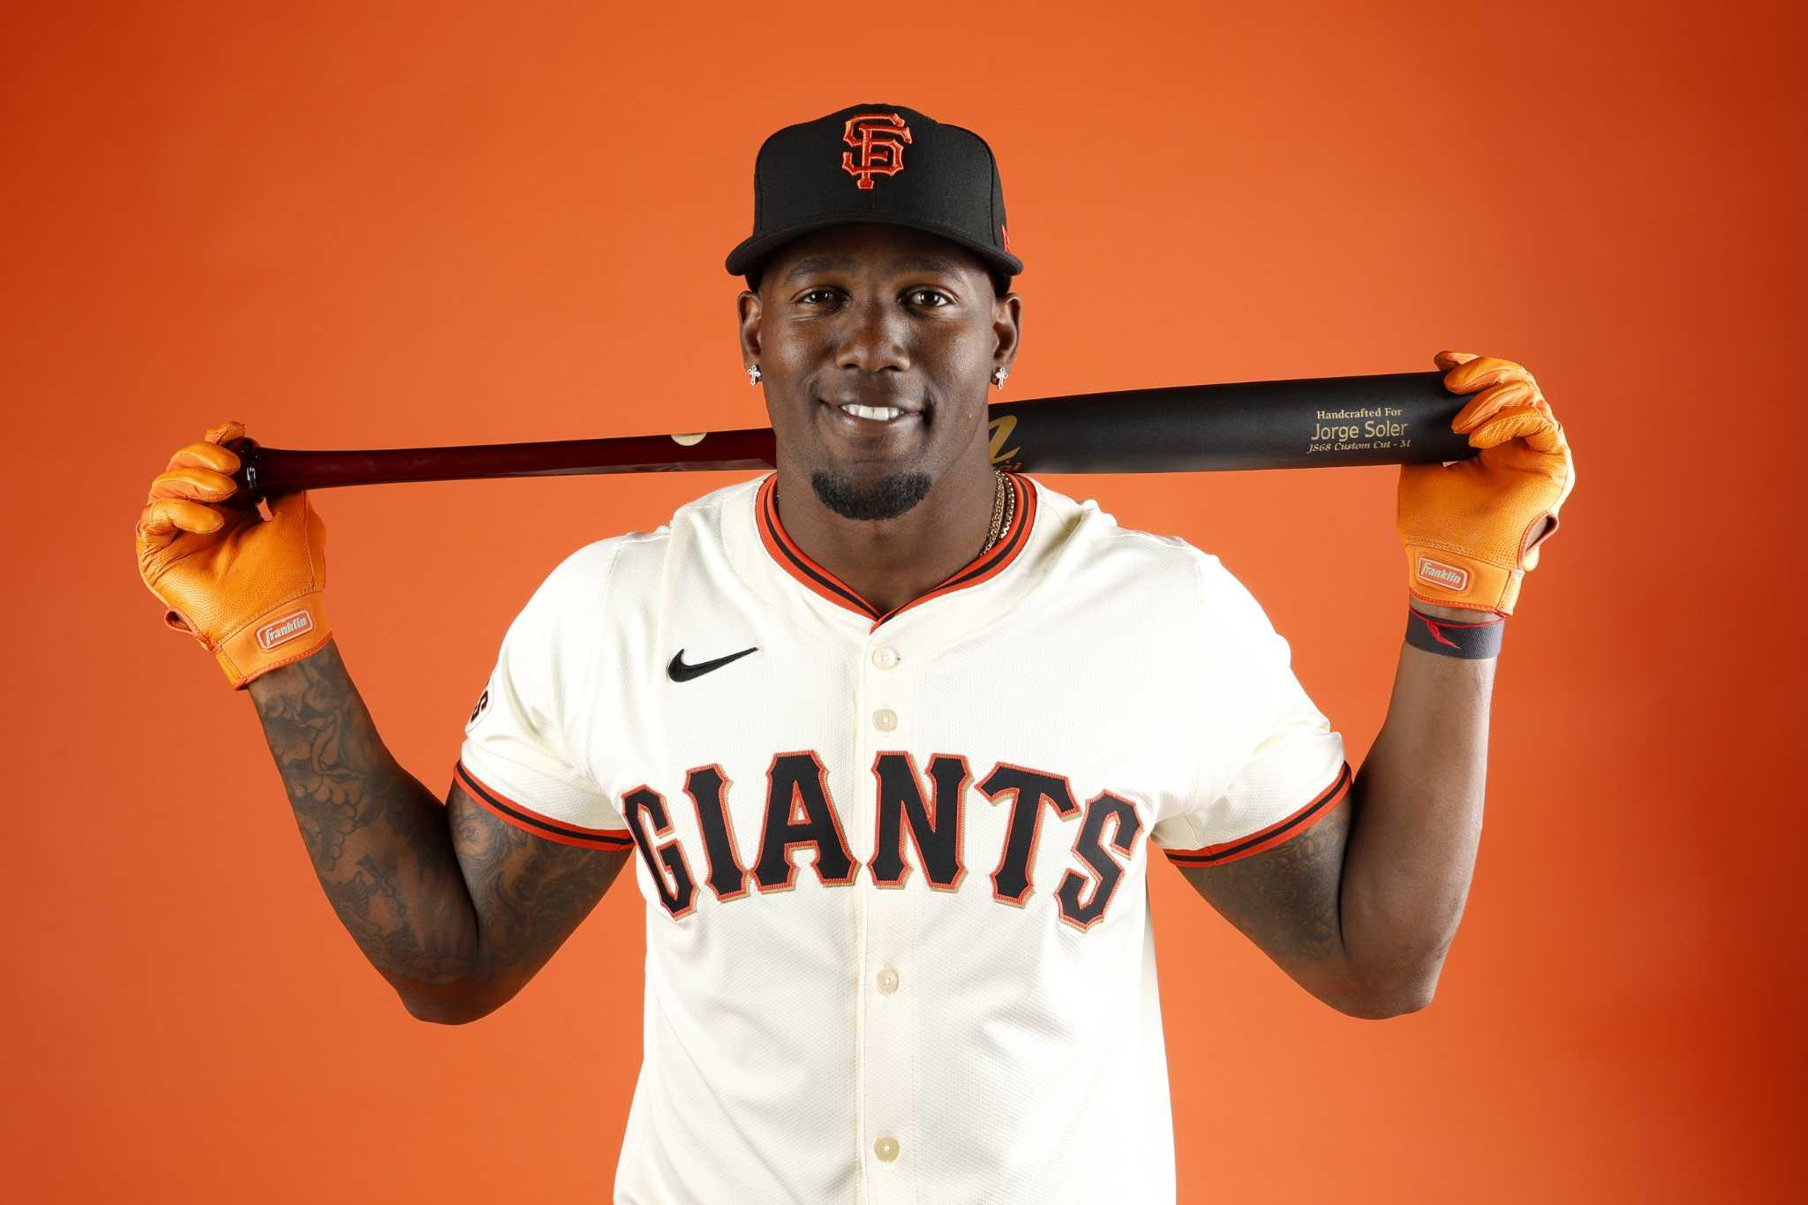
Jorge Soler
1st Half:
Def: 15th Percentile
Off: 21st Percentile
wRC+: 27th Percentile
BB%+: 70th Percentile
K%+: 27th Percentile
OBP+: 26th Percentile
SLG+: 27th Percentile
ISO+: 46th Percentile
WPA: 6th Percentile
Clutch: 3rd Percentile
WAR: 7th Percentile
2nd Half:
Def: 1st Percentile (-14)
Off: 75th Percentile (+54)
wRC+: 84th Percentile (+57)
BB%+: 98th Percentile (+28)
K%+: 30th Percentile (+3)
OBP+: 88th Percentile (+62)
SLG+: 72nd Percentile (+45)
ISO+: 77th Percentile (+31)
WPA: 88th Percentile (+82)
Clutch: 54th Percentile (+51)
WAR: 34th Percentile (+27)
Average Percentile Difference = +39 percentiles

Slide 13
Discussing Batters
Eugenio Suarez went from being unable to hit the ball, literally the worst offensive hitter, to being in the top 5% of hitters in the second half
Corbin Carroll seems to have gotten more aggressive at the plate, but it’s been rewarding as he’s now been producing runs in the top 5% of hitters
Lower BB%+
Lower K%+ (Striking out more often)
Jorge Soler has significantly improved his discipline, and in turn is generating runs at a higher level. Opposite of Carroll his selectiveness have done him good

Slide 14


